Slide 1
Database System Development Lifecycle
Based on Chapter 10
(Fifth Edition)
Notes:
September 98
1
Chapter Name

Slide 2
Main Topics
Main phases of database design: conceptual, logical, and physical design.
Benefits of CASE tools.
How to evaluate and select a DBMS.
Distinction between data administration and database administration.
2
Notes:
September 98
2
Chapter Name

Slide 3
Information System IS
Resources that enable collection, management, control, and dissemination of information throughout an organization.
Database is fundamental component of IS, and its development/usage should be viewed from perspective of the wider requirements of the organization.

Slide 4
Database development activities during the systems development life cycle (SDLC)
Project Identification
and Selection
Project Initiation
and Planning
Analysis
Logical Design
Physical Design
Implementation
Maintenance

Slide 5
Systems Development Lifecycle
Project identification and selection
Project initiation and planning
Analysis
Logical design
Physical design
Implementation
Maintenance

Slide 6
Database Application Lifecycle
Requirements collection and analysis
Database design
DBMS selection (optional)

Slide 7
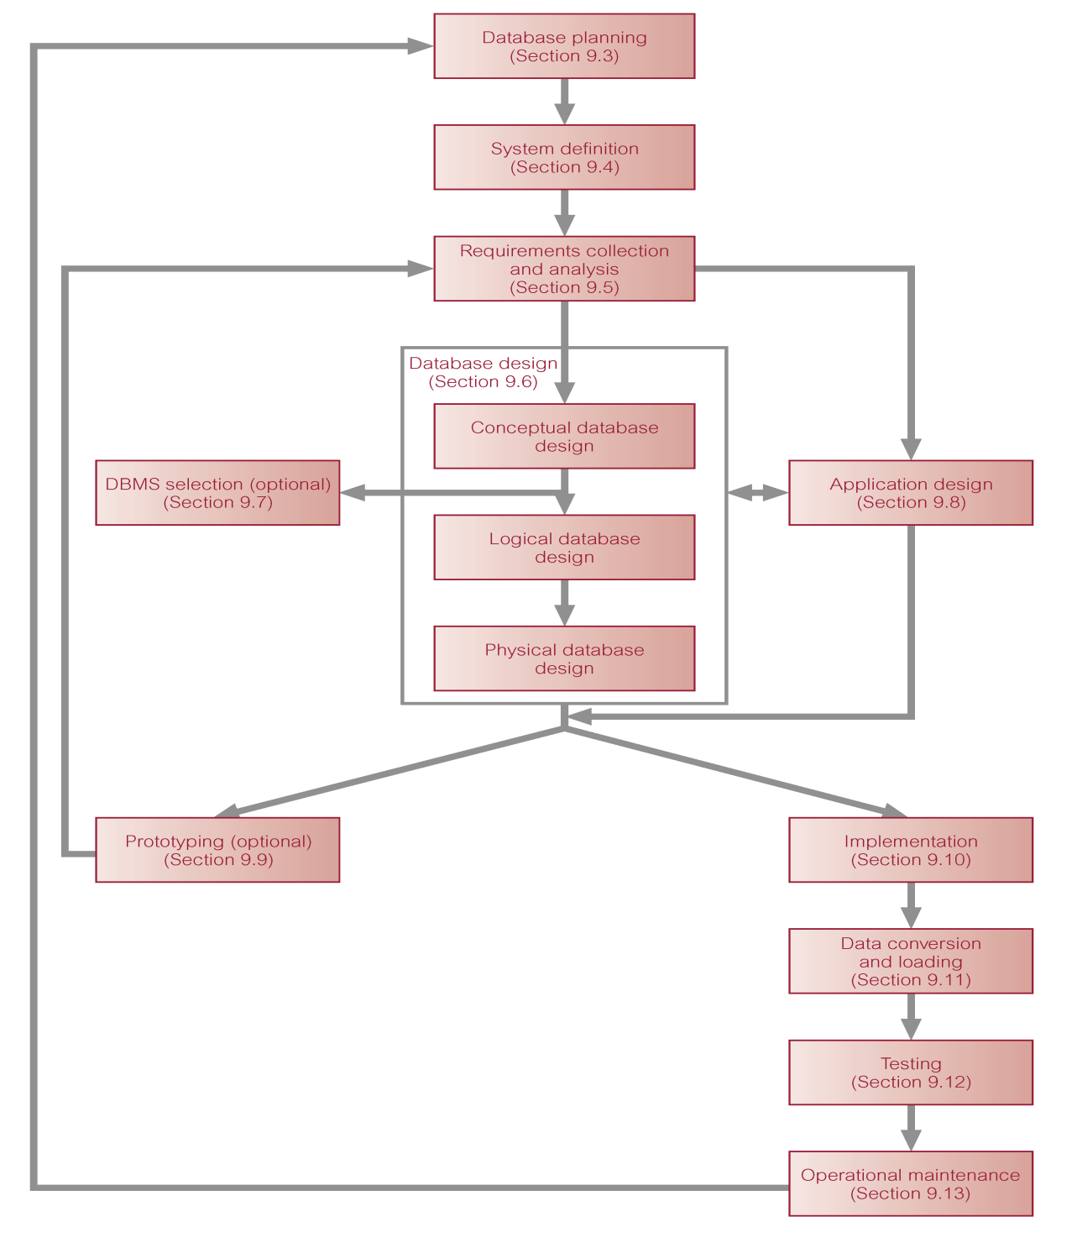
The stages of the database system development lifecycle (p. 264)

Slide 8
Database Application Lifecycle
Application design
Prototyping Implementation
Data conversion and loading
Testing
Operational maintenance.

Slide 9
Database Planning
Database planning should also include development of standards that govern:
  how data will be collected,
  how the format should be specified,
  what necessary documentation will be needed,
  how design and implementation should proceed.

Slide 10
System Definition
Describes scope and boundaries of database application and the major user views.
User view defines what is required of a database application from perspective of:
  a particular job role (such as Manager or Supervisor) or
  enterprise application area (such as marketing, personnel, or stock control).

Slide 11
Requirements Collection and Analysis
Process of collecting and analyzing information about the part of organization to be supported by the database application, and using this information to identify users’ requirements of new system.

Slide 12
Requirements Collection and Analysis
Information is gathered for each major user view including:
  a description of data used or generated;
  details of how data is to be used/generated;
  any additional requirements for new database application.

Slide 13
Requirements Collection and Analysis
Another important activity is deciding how to manage database application with multiple user views.
Three main approaches:
  centralized approach;
  view integration approach;
  combination of both approaches.

Slide 14
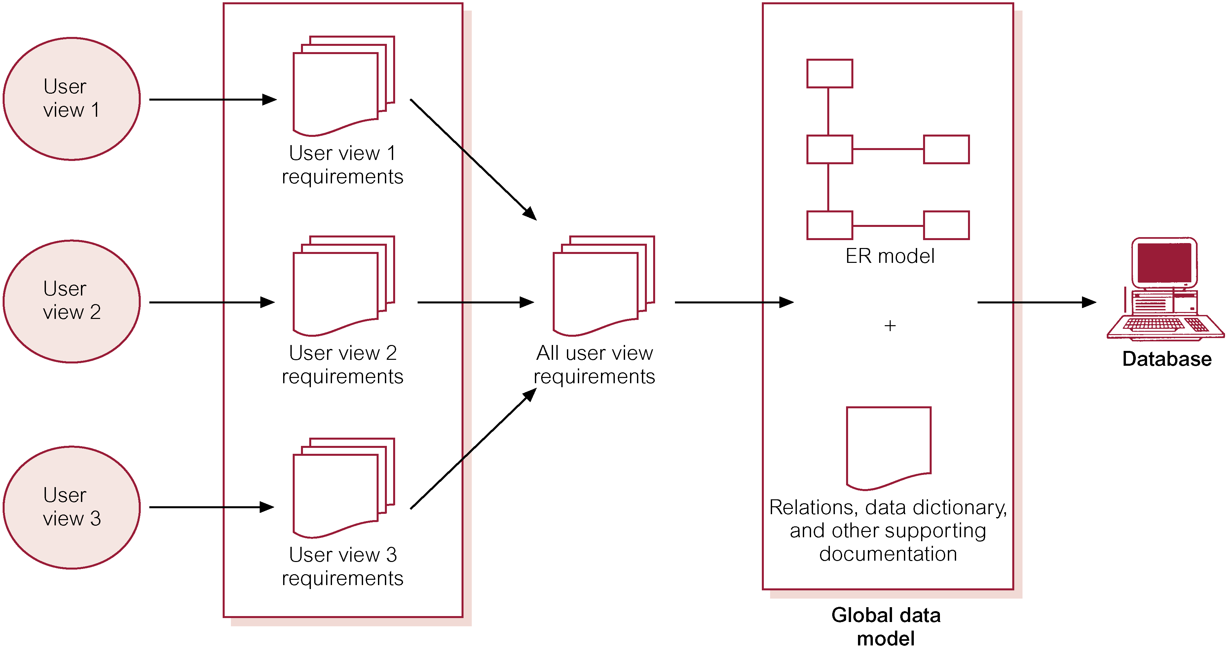
Centralized Approach to Managing Multiple User Views

Slide 15
Requirements Collection and Analysis
View integration approach
  Requirements for each user view are used to build a separate data model.

Slide 16
Requirements Collection and Analysis
Data model representing single user view is called a local data model, composed of diagrams and documentation describing requirements of a particular user view of database.
Local data models are then merged to produce a global data model, which represents all user views for the database.

Slide 17
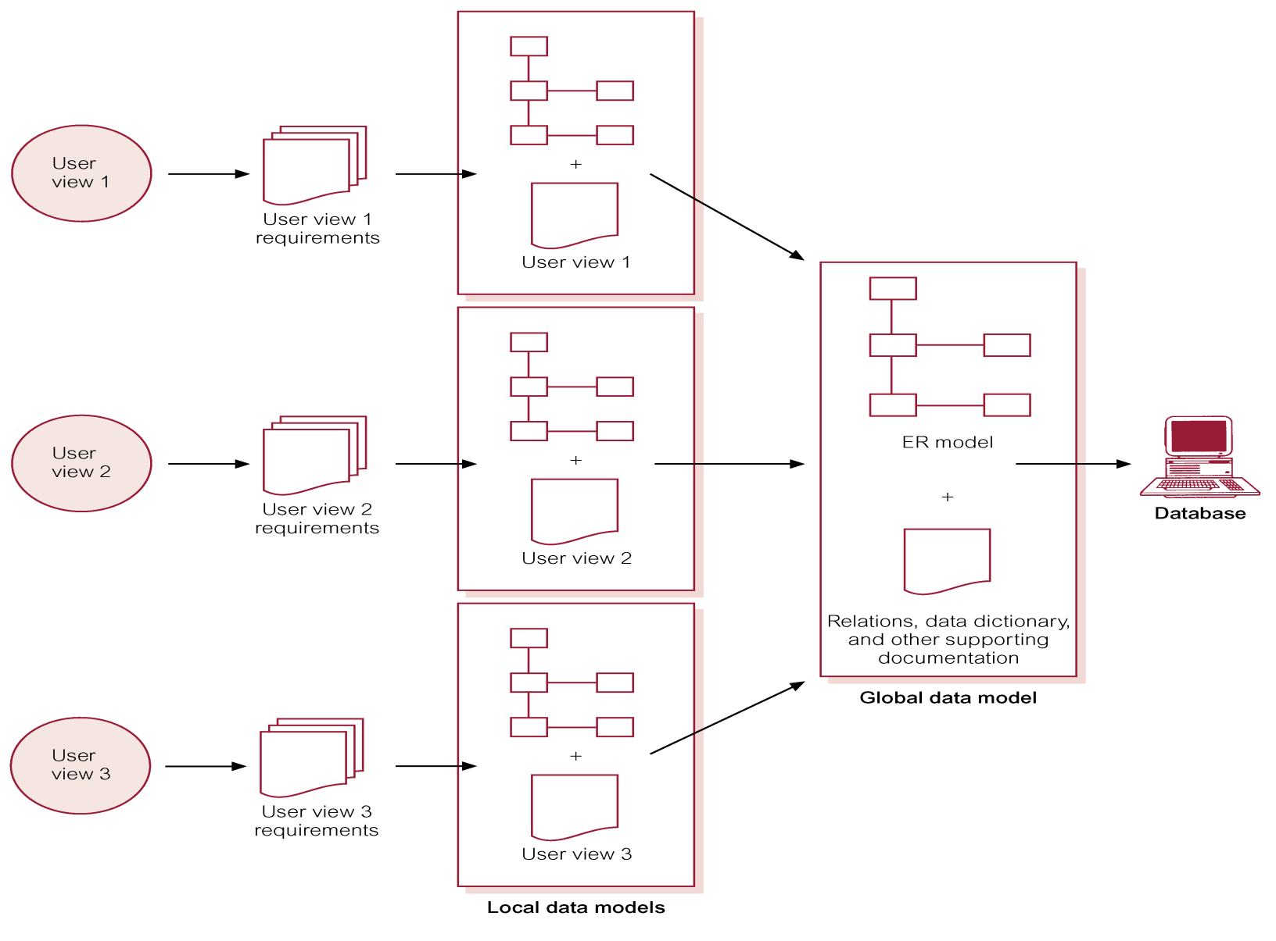
View Integration Approach to Managing Multiple User Views

Slide 18
Database Design
Major aims:
  Represent data and relationships between data required by all major application areas and user groups.
  Provide data model that supports any transactions required on the data.
  Specify a minimal design that is appropriately structured to achieve stated performance requirements for the system (such as response times).

Slide 19
Database Design
Approaches include:
  Top-down
  Bottom-up
  Inside-out
  Mixed

Slide 20
Database Design
Main purposes of data modeling include:
  to assist in understanding the meaning (semantics) of the data;
  to facilitate communication about the information requirements.
Building data model requires answering questions about entities, relationships, and attributes.

Slide 21
Database Design
A data model ensures we understand:
  - each user’s perspective of the data;
  - nature of the data itself, independent of its physical representations;
  - use of data across user views.

Slide 22
Database Design
Three phases of database design:
  Conceptual database design
  Logical database design
  Physical database design.

Slide 23
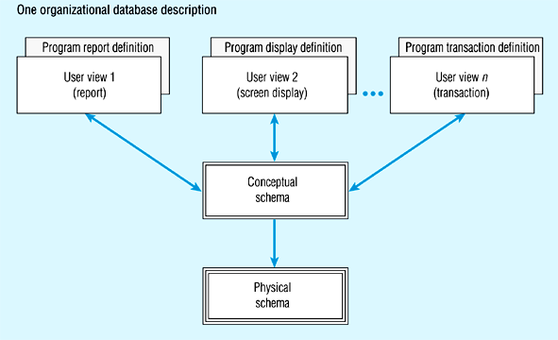
Three-schema database architecture

Slide 24
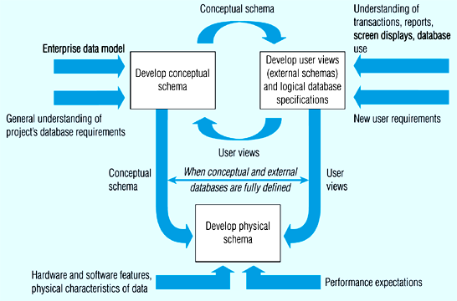
Process of developing three-schema architecture for a database project

Slide 25
Conceptual Database Design
Process of constructing a model of the information used in an enterprise, independent of all physical considerations.
Data model is built using the information in users’ requirements specification.
Source of information for logical design phase.

Slide 26
Logical Database Design
Process of constructing a model of the information based on a specific data model (e.g. relational, OO), but independent of a particular DBMS and other physical considerations.
Conceptual data model is refined and mapped on to a logical data model.

Slide 27
Physical Database Design
Process of producing a description of the database implementation on secondary storage.
Describes storage structures and access methods used to achieve efficient access to data.
Tailored to a specific DBMS system.

Slide 28
DBMS Selection
Selection of an appropriate DBMS to support the database application.
Main steps to selecting a DBMS:
  define Terms of Reference of study;
  shortlist two or three products;
  evaluate products;
  recommend selection and produce report.

Slide 29
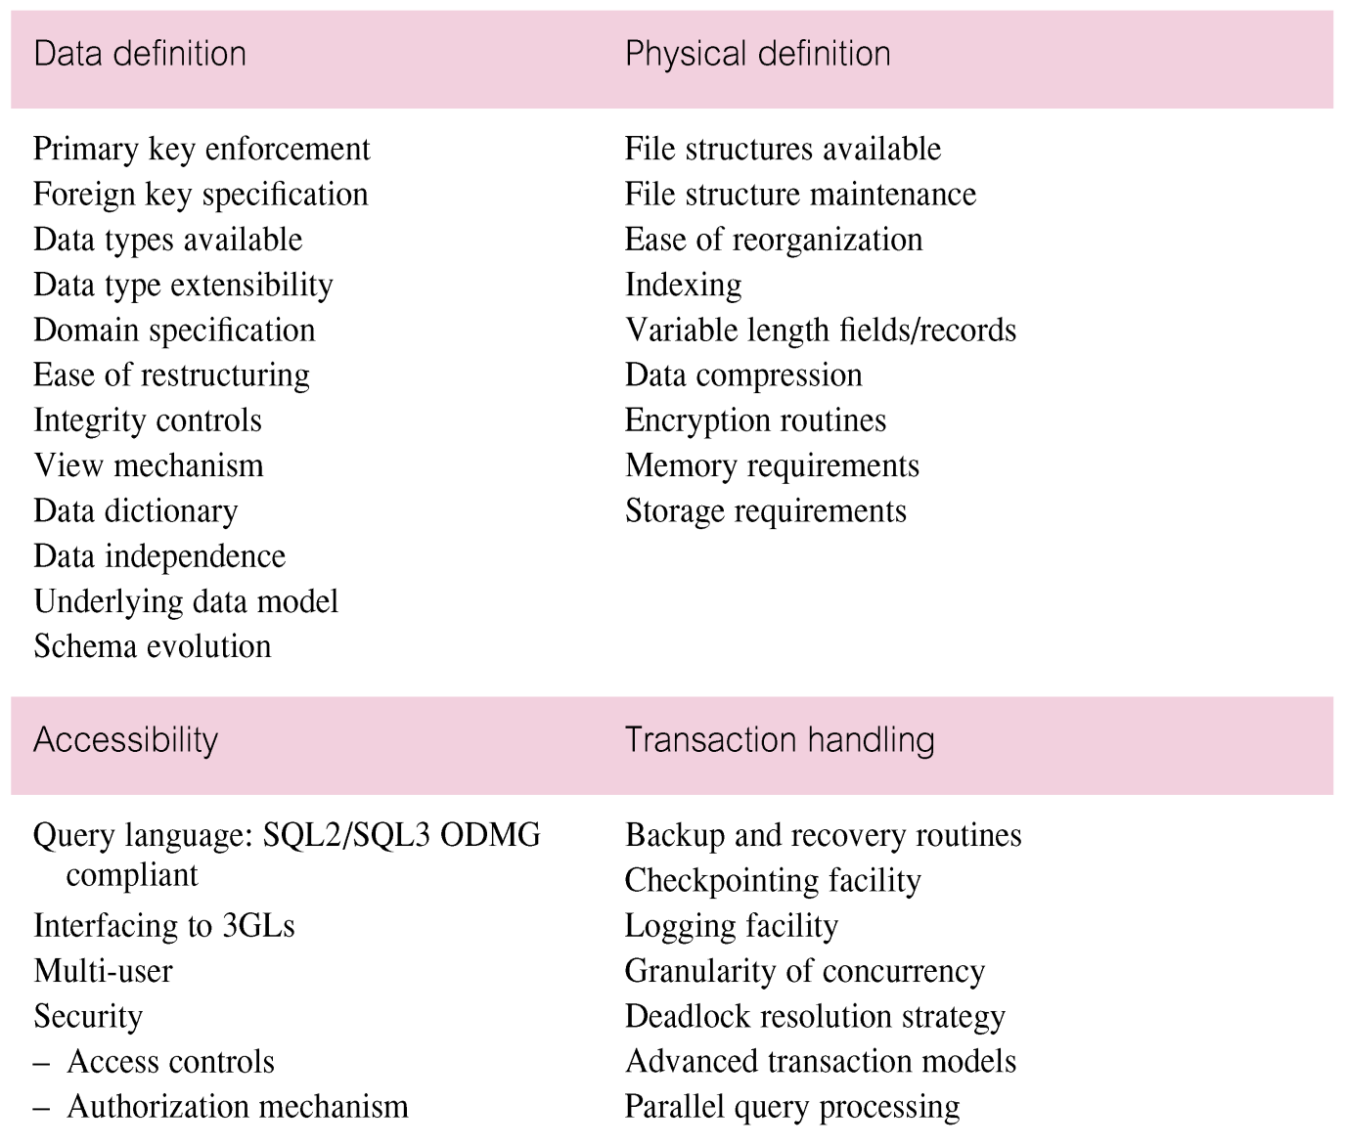
DBMS Evaluation Features

Slide 30
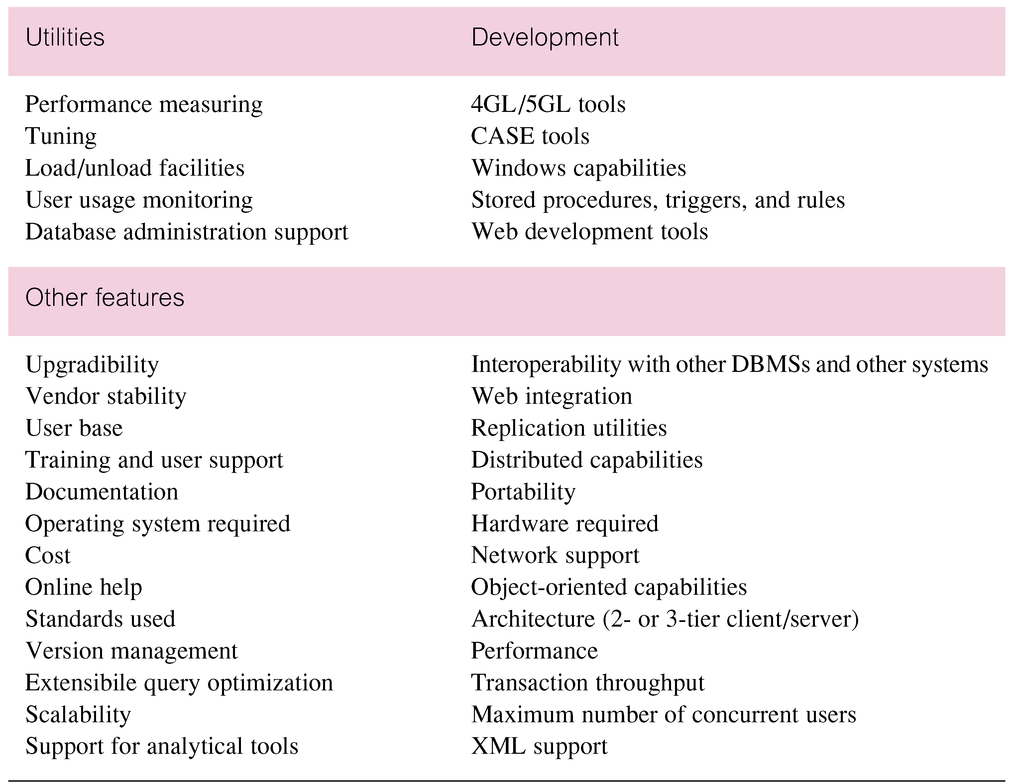
DBMS Evaluation Features

Slide 31
Application Design
Design of user interface and application programs that use and process the database.
Database and application design are parallel activities.
Includes two important activities:
  transaction design;
  user interface design.

Slide 32
Transactions
An action, or series of actions, carried out by a single user or application program, which accesses or changes content of the database.
Example: Money transfer

Slide 33
Application Design - Transactions
Important characteristics of transactions:
  data to be used by the transaction;
  functional characteristics of the transaction;
  output of the transaction;
  importance to the users;
  expected rate of usage.
Three main types of transactions: retrieval, update, and mixed.

Slide 34
Prototyping
Building working model of a database application.
Purpose
  to identify features of a system that work well, or are inadequate;
  to suggest improvements or even new features;
  to clarify the users’ requirements;
  to evaluate feasibility of a particular system design.

Slide 35
Implementation
Physical realization of the database and application designs.
  Use DDL to create database schemas and empty database files.
  Use DDL to create any specified user views.
  Create the application programs.

Slide 36
Data Conversion and Loading
Transferring any existing data into new database and converting any existing applications to run on new database.

Slide 37
Testing
Process of executing application programs with intent of finding errors.
Use carefully planned test strategies and realistic data.
Testing cannot show absence of faults; it can show only that software faults are present.
Demonstrates that database and application programs appear to be working according to requirements.

Slide 38
Operational Maintenance
Process of monitoring and maintaining system following installation.

Slide 39
CASE Tools
Support provided by CASE tools include:
  - data dictionary to store information about database application’s data;
  - design tools to support data analysis;
  - tools to permit development of corporate data model, and conceptual and logical data models;
  - tools to enable prototyping of applications.

Slide 40
CASE Tools
Provide following benefits:
  standards;
  integration;
  support for standard methods;
  consistency;
  automation .

